Slide 1

Variable Names in Compiler and Interpreter Methods
YeongWon Jeon
School of Electronic and Electrical Engineering, KNU, KOREA
2024.06.28

Slide 2
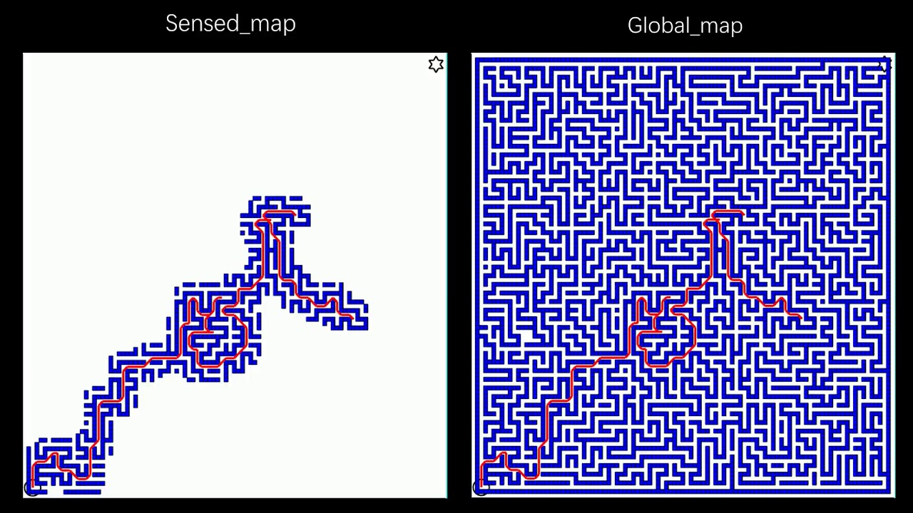
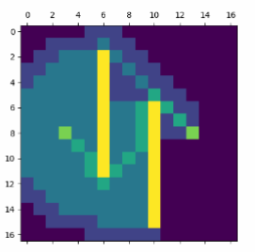
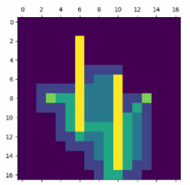
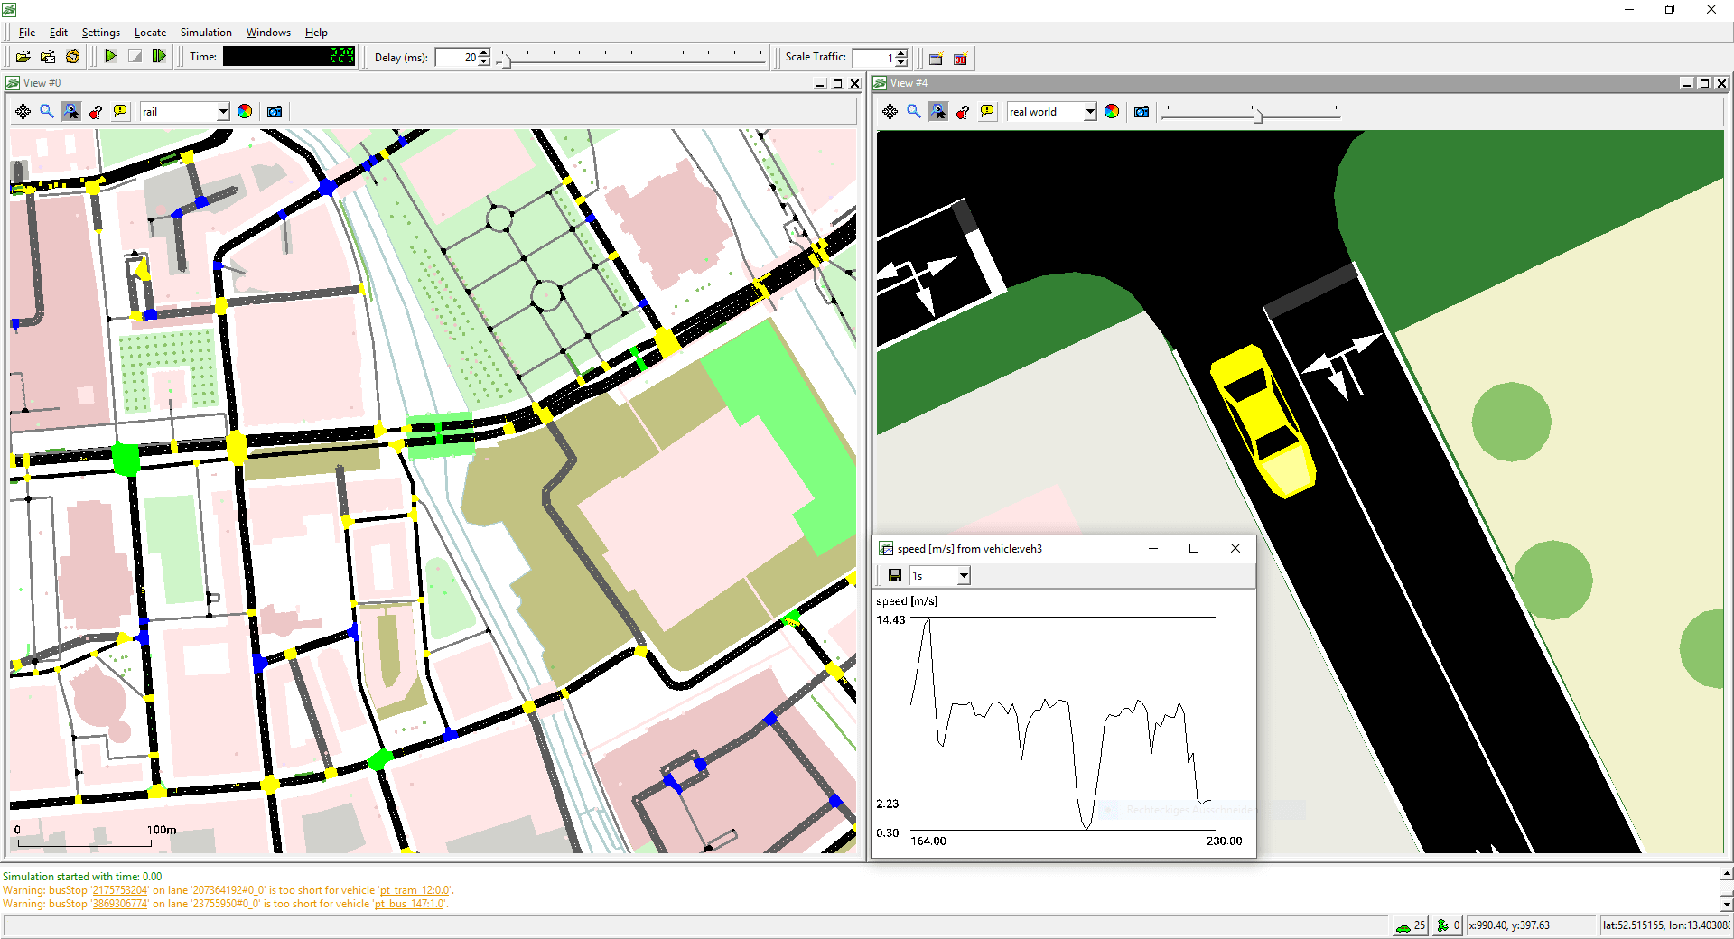
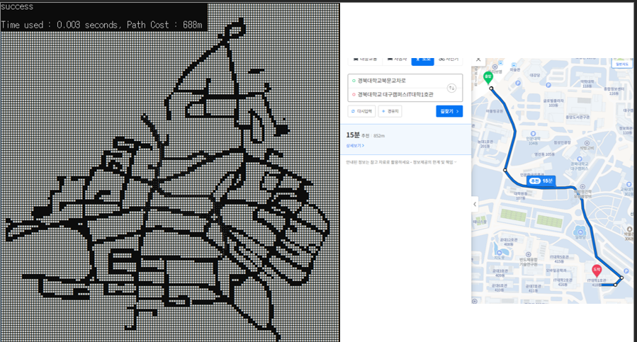
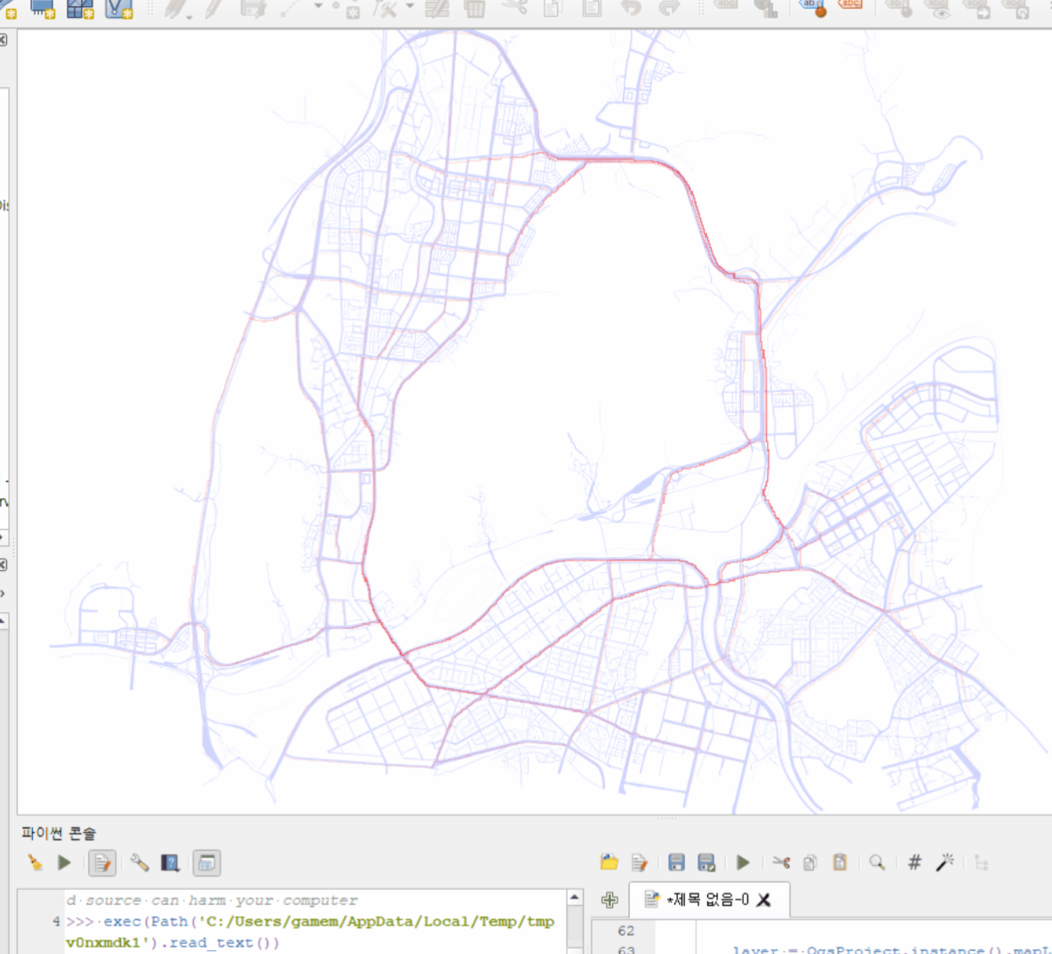
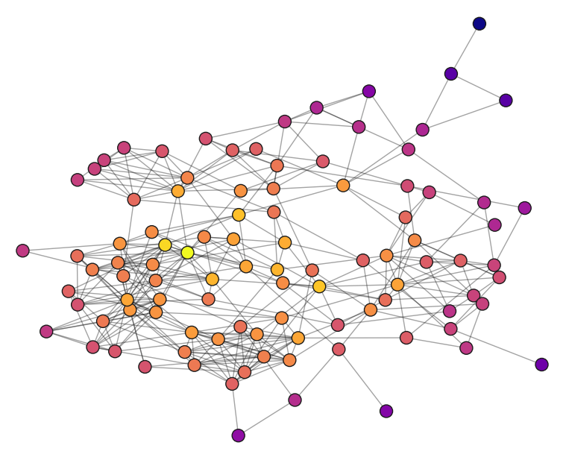
Adaptive A* algorithm
D* algorithm
Simulation of Urban MObility
Adaptive A*
Multi Agent A*
Apply on-chip communication

Slide 3
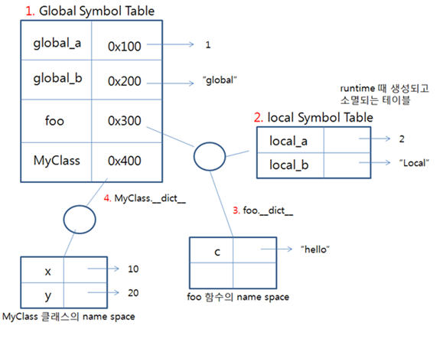
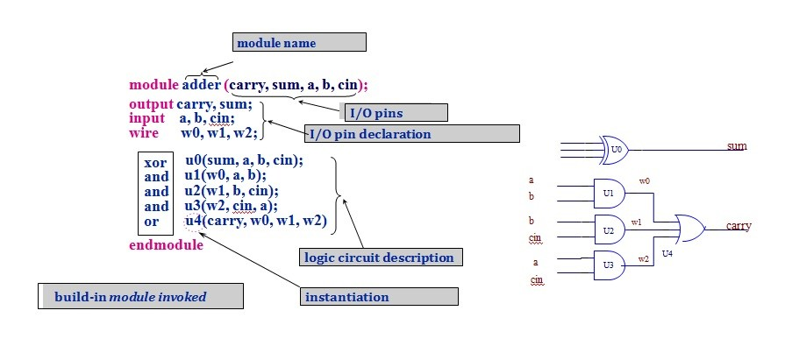
Compiler and Interpreter Methods
Variable in compiler and interpreter methods
Low-level structure as : OS, Compiler, Assembly
HDL : Verilog

